Slide 1
Employee Repricing & Discounts

Slide 2
Agenda
Introduction
Context, Solution and Considerations
Employee Pricing Solution Architecture(Custom to Client requirement)
Potential Applications Areas
Notes:
This is a note.

Slide 3
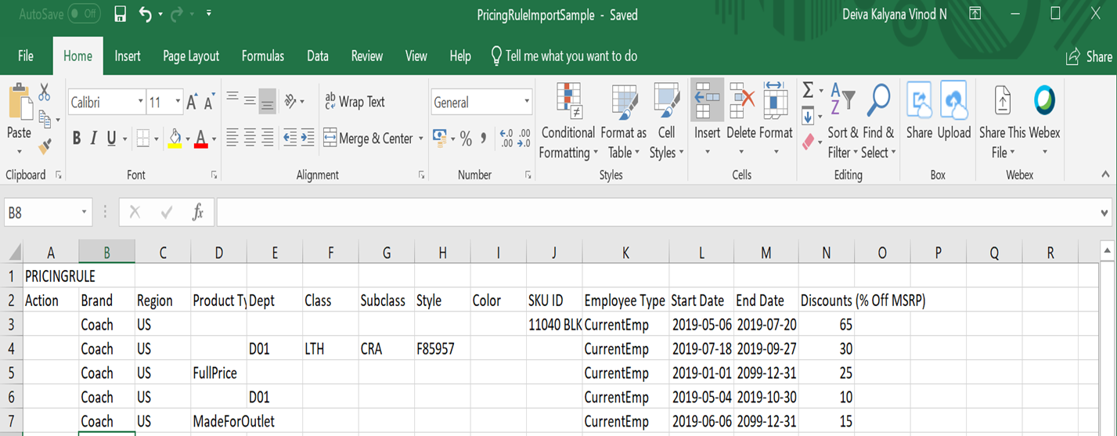
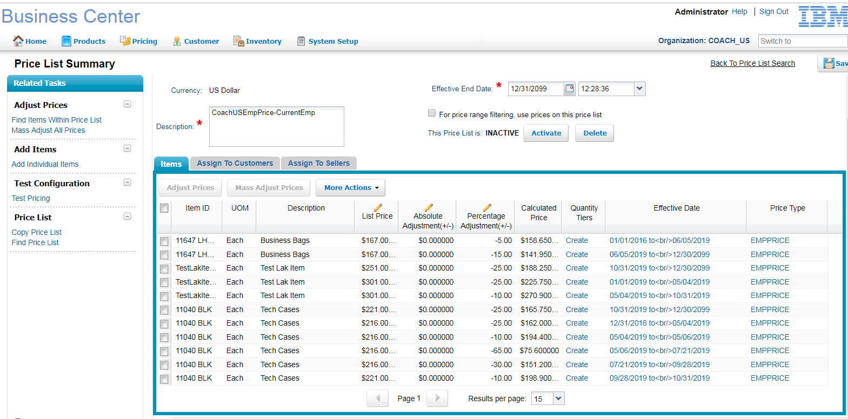
Context and Solution
Requirement
Develop a price rule engine to determine employee discounts across products
Solution
IBM OMS promotion feature (OOTB pricing rules) will be leveraged to model the discount rules for employee purchases.
Considerations
Disjointed pricing rules across SKU, style, categories and Item Attributes.
Discounts overlapping across date ranges

Slide 4
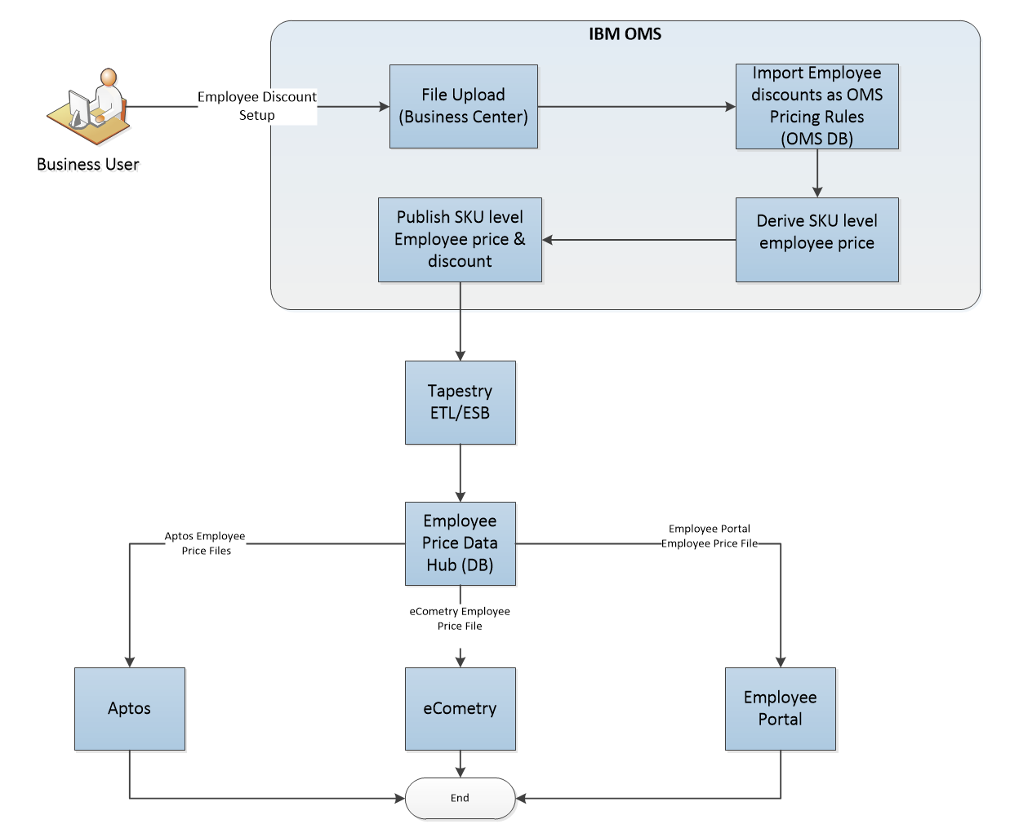
Employee Pricing Client Solution Architecture

Slide 5
Sample Pricing Rule File

Slide 6
Employee Price

Slide 7
Products and Features leveraged
Products
IBM Sterling Order Management (OMOC V19.2)
IBM Sterling Business center
Web sphere application server
DB2 V10.5
Features
Pricing Modules - IBM OMS Promotion feature(Pricing Rules)
Asynchronous request processor agent

Slide 8
Potential Application Areas
To roll out various Employee Discounts for Retail Customers especially Fashion Retailers.
Employee Discount determination on special days (Christmas, Thanks giving), clearance sale and events.
Compute internal employee discounts across products and promotions

Slide 9
Notes:
9

