Slide 1
IBM Sterling File Gateway
User Authentication By Token
2019 | Informação de Uso Interno

Slide 2
IBM Sterling File Gateway

Slide 3
Agenda
Motivator
Risks
Solution

Slide 4
IBM Sterling File Gateway
Motivator

Slide 5
Motivator
What we want...
Mitigate security risks involving the IBM Sterling File Gateway platform through the use of a second authentication factor.
Keep the second authentication factor optional and configurable per user.
Develop a component (plugin or exit) that authenticates the user's token when logged into the MyFileGateway portal.
Maintain the password base within the IBM Sterling File Gateway. (local)

Slide 6
Motivator
Security Levels
muito altaSegurança
4
Very High
Level 3 + Client computer validation (HASH) and Token Authentication
3
High
Level 2 + cross authentication with digital certificate
High
Security
2
Medium
Level 1 + client’s IP address validation
Medium
Security
1
Low
Authentication by user and password
Low
Security

Slide 7
IBM Sterling File Gateway
Risks

Slide 8
Risks
Risks
Credentials
Location
Identity
Fragility
Quebra da senha de acesso
Password capture by malicious applications
Mitigation
Double authentication factor (IP, token, certificate, etc.)
Fragility
It is not possible to identify if the customer is doing the access from a known site, for example: your company
Mitigation
Client IP validation
Fragility
Guarantee that the access was made by the customer and not by another person
Mitigation
Client access device hash validation
Validation of client's public certificate
Access token validation

Slide 9
IBM Sterling File Gateway
Solution

Slide 10
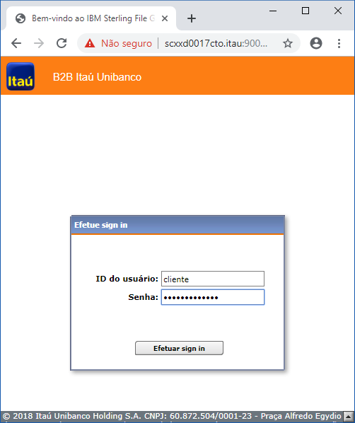
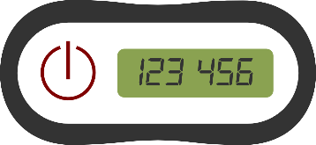
Solution
Authentication with token and password
01 Token
The user enters the first token numbers in the password field (fixed size 6 positions)
03 Exit
Separates the token from the password, then authenticates the user's token
+
04 Exit
Requests IBM Sterling File Gateway to authenticate only the user's password
02 Senha
After the token, the user enters his access password

Slide 11
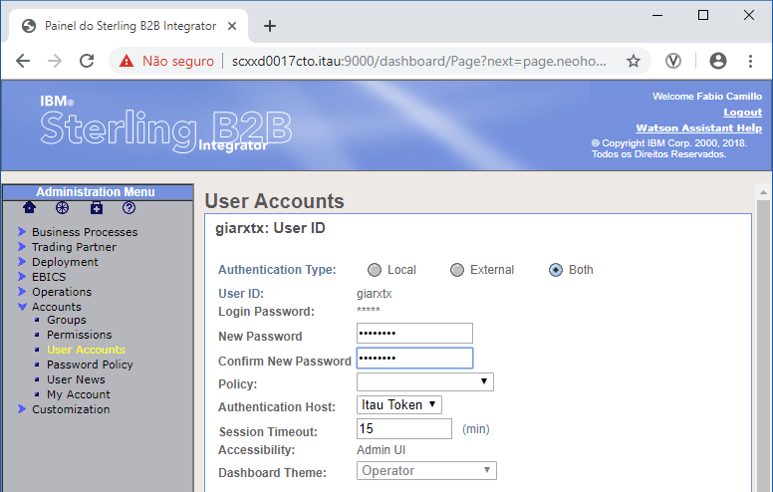
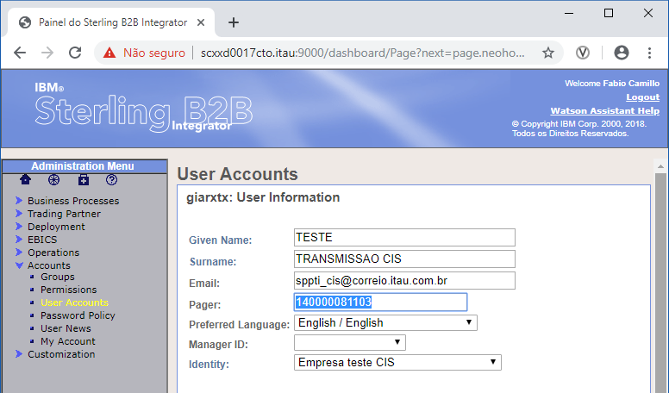
Solution
Authentication with token and password
01 Exit
For the Exit perform a token authentication, it queries the user's registry for the serial number of the token that is to be authenticated. This number is registered in the "Pager" field of the user registry in IBM B2B Integrator.
02 Exit
The Authentication Plugin is entered in the "Authentication Host" field in the user registry and as we want to authenticate the password in IBM B2B Integrator we leave the "Authentication Type" option as "Both".

Slide 12
Solution
So, what we did?
1th try
Implemented the pre-authentication exit (JAVA interface IUserLoginUserExit_preAuthenticate), however it is not possible to only pass the password to the next phase.
We would like to be able to send only the user's password (without the first 6 digits of the token) to the next phase of authentication.
2nd try
Created a plugin to perform authentication (JAVA IAuthentication interface), however we do not have a method to request the IBM Sterling File Gateway to perform authentication only for the user's password.
We would like to have a method where you can enter the user and password and IBM Sterling File Gateway inform us if the password is valid for the user.

Slide 13
Solution
References...
Pre-Authentication Exit Creation
https://www.ibm.com/developerworks/community/blogs/SterlingB2B/entry/Login_and_Logout_User_Exits_in_SB2Bi_5_2_5_5_2_6_FixPack?lang=en
Authentication Plug-in Creation
https://www.ibm.com/developerworks/community/wikis/home?lang=en#!/wiki/Wf96854c0c8fc_4762_9b83_c6247feca5fc/page/Custom%20User%20Authentication%20Plug-in

